Slide 1

WIS 2.0 Training Workshop, Windhoek, Namibia, 20-24 March 2023​
WIS2 box case studies
Enrico Fucile
Head, Data and Information Management Division

Slide 2
WIS2 box case studies
Malawi
Morocco and Algeria
WIS2 Africa

Slide 3

Malawi project first implementation
WMO MQP broker
Data logger
MS SQL server
MQP notification
MQP notification
EC2 Windows
Server
MQP notification
DWD
http
AWS lambda
ECMWF
S3 bucket
http
Amazon Web Services

Slide 4
WIS2 in a box
Principles
Demonstration projects
WIS2 in a box
Architecture
Implementation
Workshop on WIS 2.0 demonstration projects
Demonstration of WIS 2.0 principles by WMO Community
Foundation of WIS 2.0 Architecture
WIS2 in a box
Facilitate adoption of WIS2 by Members
Reference implementation of the Technical Regulations of WIS2
WIS2 in a box
Open-source reference implementation of WIS 2.0 for LDC, SIDS and Members adopting open-source solutions
Plug and play
Data exchange
Use & Visualize
Discover
Monitor
Notes:
WIS2 principle underpinning WIS2 technical framework → Demonstration projects to test the principles and provide basis for the architecture → demonstration projects workshop → recommendation to start WIS2 in a box project

Slide 5




Malawi project
ftp
WIS2 box
ftp server
CSV to BUFR
ftp
BUFR GeoJSON
ftp
Data Services
WEB API
HTTP Server
MQTT Broker
Amazon Web Services
New data notification
Subscribe
http
Python
Excel
GDPFS Center
ECMWF DWD

Slide 6
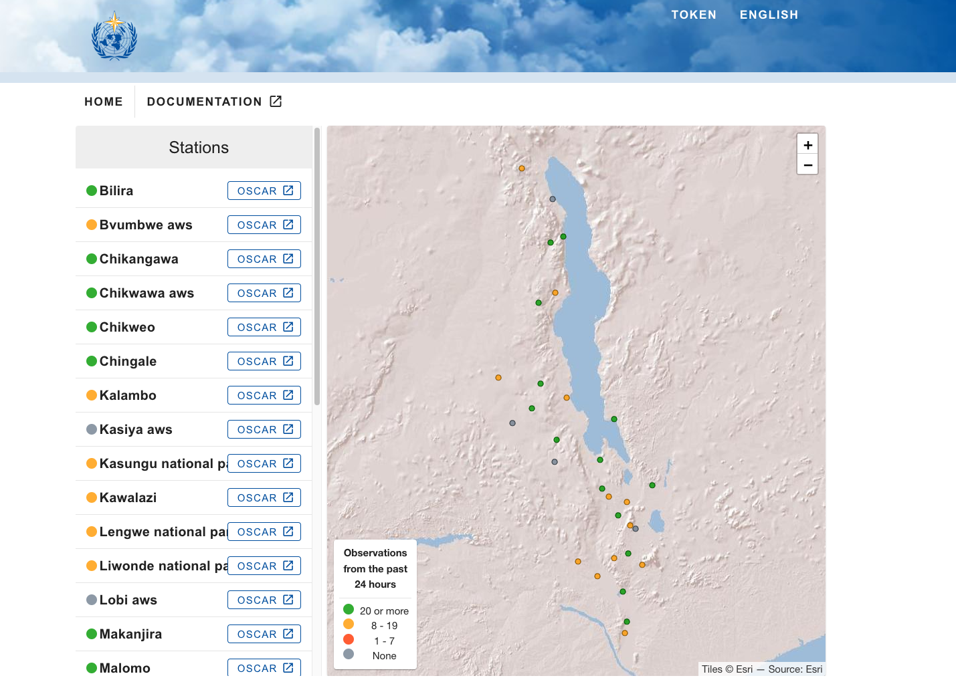
WIS2 in a box Malawi data
https://demo.wis2box.wis.wmo.int/malawi/
8 March 2023
14 stations green
12 station yellow
3 station gray
WIS2 box running on Amazon Web Services managed by Secretariat

Slide 7
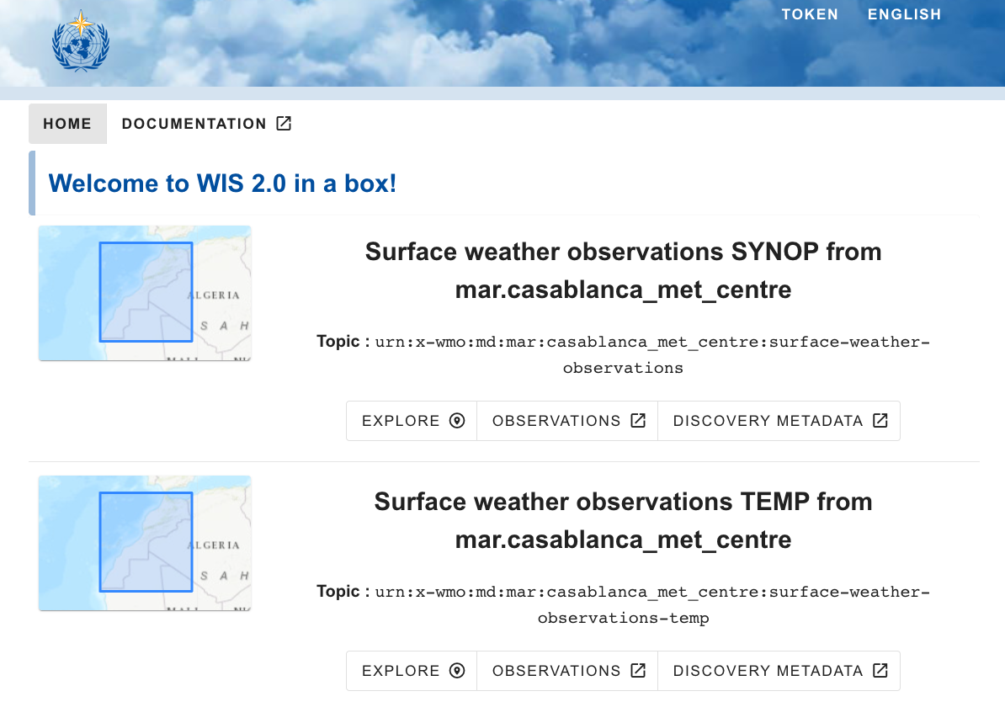
WIS2 in a box Morocco
http://wis2box.marocmeteo.ma
WIS2 box running on a server on premises

Slide 8
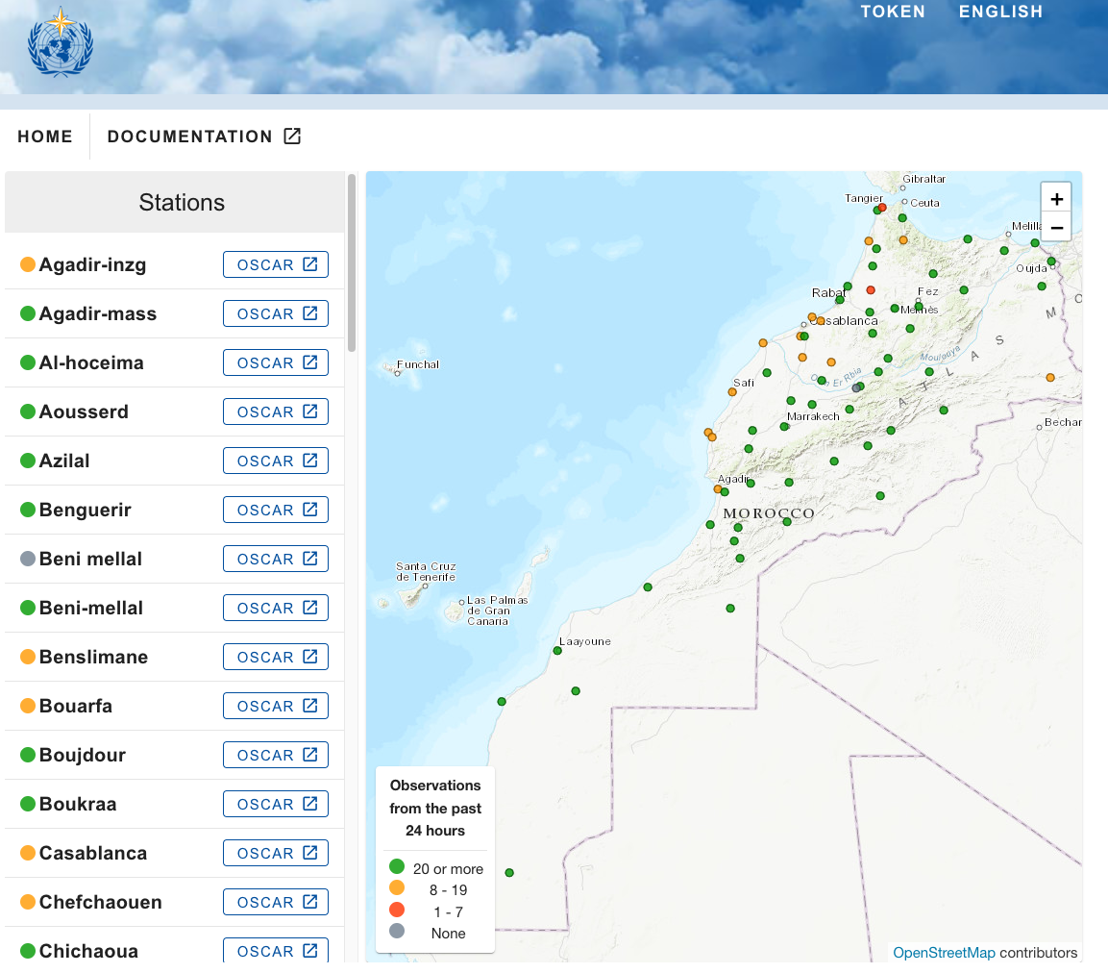
WIS2 in a box Morocco data
http://wis2box.marocmeteo.ma

Slide 9
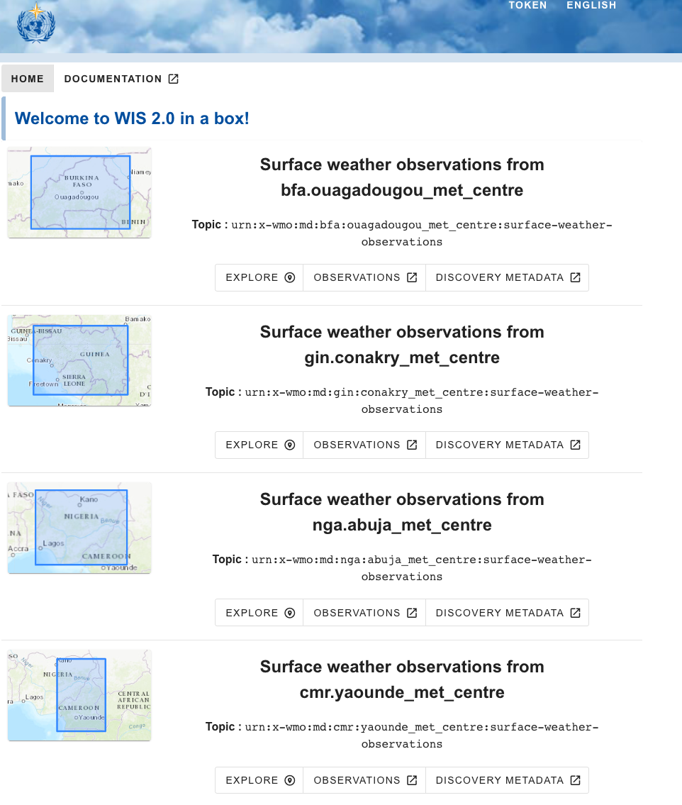
WIS2 in a box for Africa run by Morocco
http://wis2africa.marocmeteo.ma
Burkina Faso → bfa
Guinea → gin
Nigeria → nga
Cameroon → cmr

Slide 10
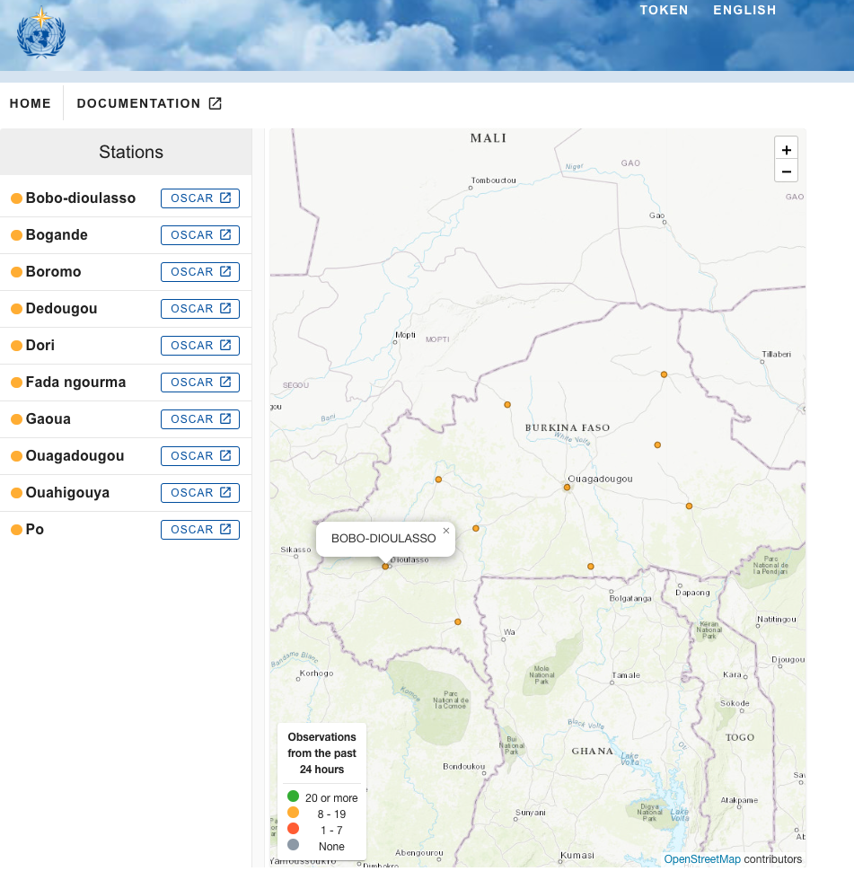
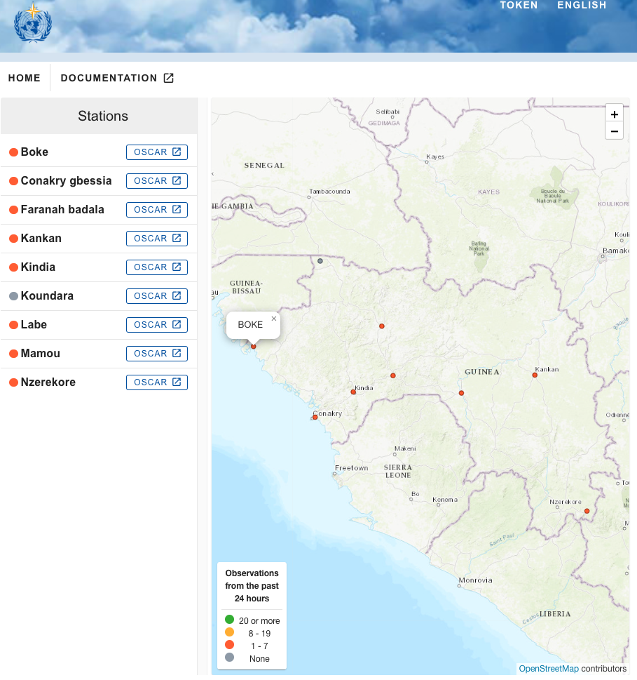
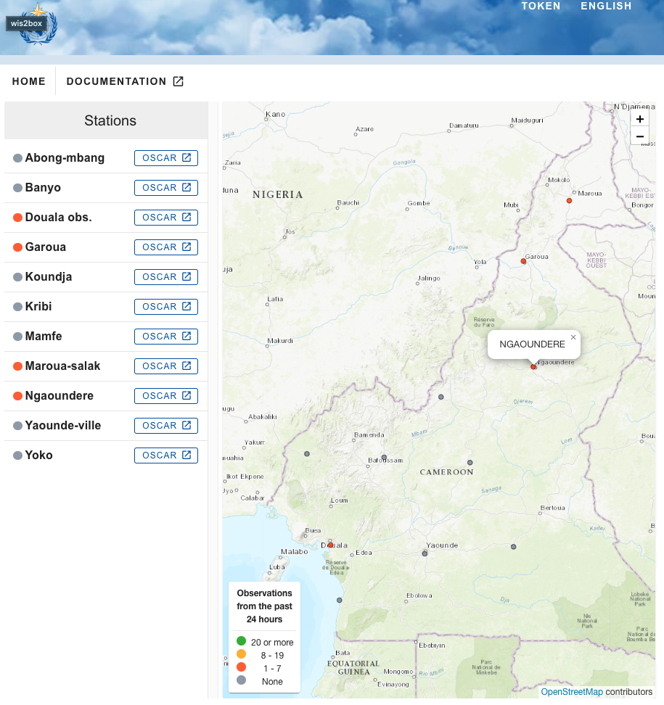
WIS2 in a box for Africa run by Morocco

Slide 11
Thank you
Merci

